Slide 1
Continuous Integration with Jenkins
Lecture 18

Slide 2

How to install Jenkins
https://www.guru99.com/download-install-jenkins.html

Slide 3
Jenkins Pipeline
With the introduction of the Pipeline plugin, users now can implement a project’s entire build/test/deploy pipeline in a Jenkinsfile and store that alongside their code, treating their pipeline as another piece of code checked into source control.

Slide 4
Jenkins Pipeline
The definition of a Jenkins Pipeline is written into a text file (called a Jenkinsfile) which in turn can be committed to a project’s source control repository.
Creating a Jenkinsfile and committing it to source control provides immediate benefits:
Automatically creates a Pipeline build process for all branches and pull requests.
Code review/iteration on the Pipeline (along with the remaining source code).
Audit trail for the Pipeline.
Single source of truth for the Pipeline, which can be viewed and edited by multiple members of the project.

Slide 5
Pipeline Concepts
Pipeline - A Pipeline is a user-defined model of a CD pipeline. A Pipeline’s code defines your entire build process, which typically includes stages for building an application, testing it and then delivering it.
Node - A node is a machine which is part of the Jenkins environment and is capable of executing a Pipeline.
Stage - A stage block defines a conceptually distinct subset of tasks performed through the entire Pipeline (e.g. "Build", "Test" and "Deploy" stages), which is used by many plugins to visualize or present Jenkins Pipeline status/progress.
Step - A single task. Fundamentally, a step tells Jenkins what to do at a particular point in time (or "step" in the process).

Slide 6
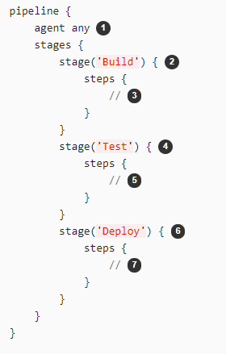
Pipeline Syntax Overview
Execute this Pipeline or any of its stages, on any available agent.
Defines the "Build" stage. However, implementing stage blocks in a Scripted Pipeline provides clearer visualization of each `stage’s subset of tasks/steps in the Jenkins UI.
Perform some steps related to the "Build" stage.
Defines the "Test" stage.
Perform some steps related to the "Test" stage.
Defines the "Deploy" stage.
Perform some steps related to the "Deploy" stage.

Slide 7
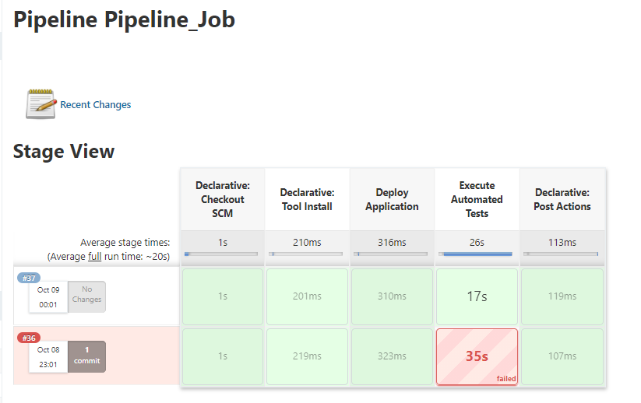
Jenkins Pipeline UI View
How to create a Pipeline Jenkins Job here: https://www.jenkins.io/doc/book/pipeline/getting-started/

Slide 8
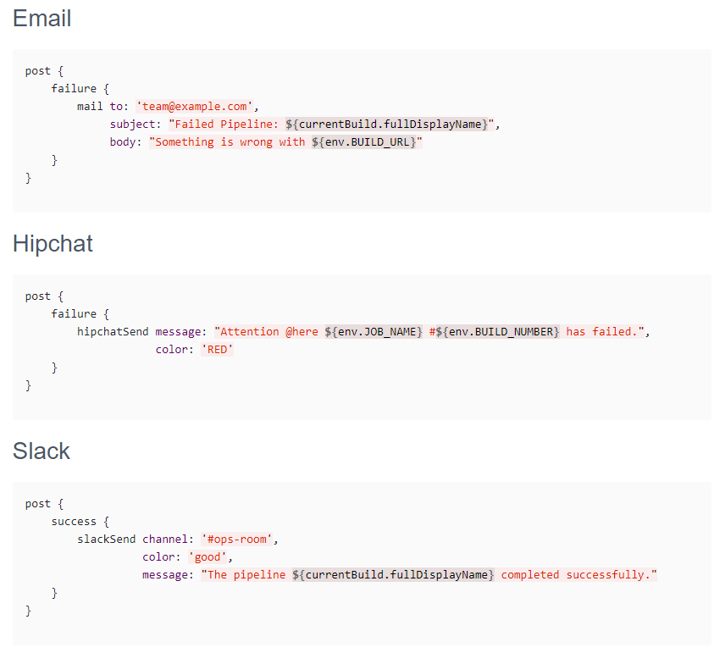
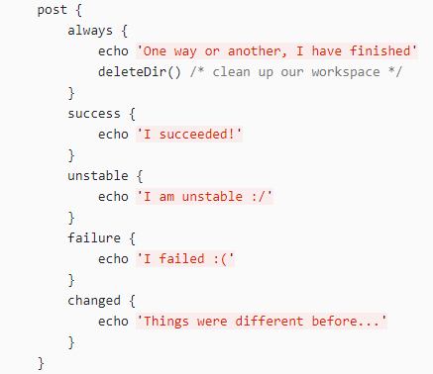
Jenkins Pipeline Post Actions

Slide 9
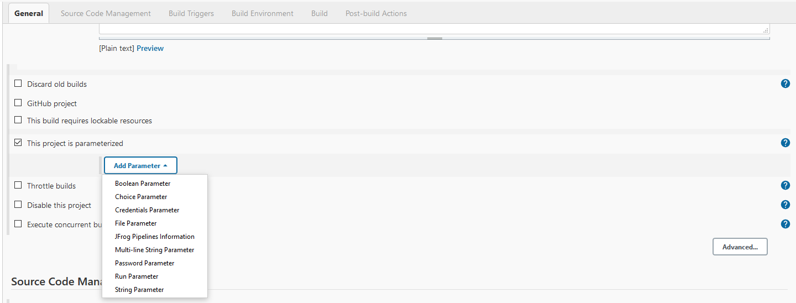
Parametrized Jobs
In Jenkinsfile - Pipeline approach
Using Jenkins UI

Slide 10
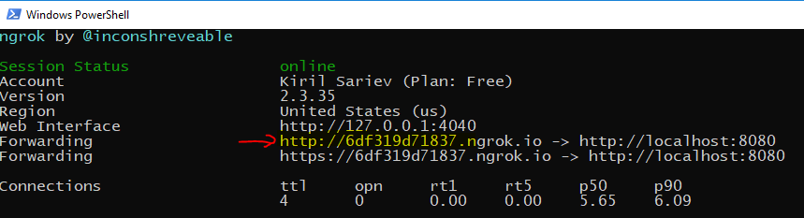
Make Your jenkins Public using NGROK
Your Jenkins is accessible on https://localhost:8080 but this is not working in internet. You have to use a tool that can make your local host, public IP
You can use ngrok tool => https://dashboard.ngrok.com/get-started/setup
Download the zip for Windows
Unzip it and open Powershell console from the directory
Run the following command => ./ngrok authtoken <your_auth_token>
Run the command => ./ngrok http 8080
Get the generated public URL from the console and add it to Github

Slide 11
GitLab Hook Integration
https://youtu.be/65hrCvYMLqo

Slide 12


